Slide 1
Back-ends? Where we’re going, we don’t need….back-ends……
A SURVEY OF THE STATIC SITE GENERATION ECOSYSTEM
Steven Hicks
pleepleus88.github.io
steven.hicks@centare.com

Slide 2

WHO IS THIS GUY?
Steven Hicks
Full-stack web developer at Centare
>15 years experience
http://pleepleus88.github.io
steven.hicks@centare.com

Slide 3
AN ABRIDGED HISTORY OF THE WEB
Notes:
so let’s start with an abridged history of the internet.

Slide 4
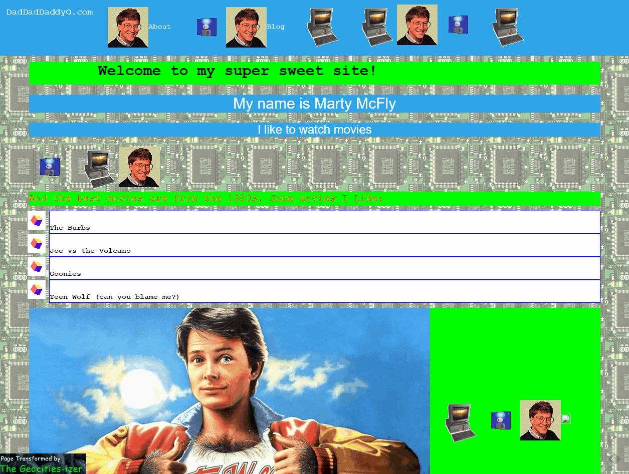
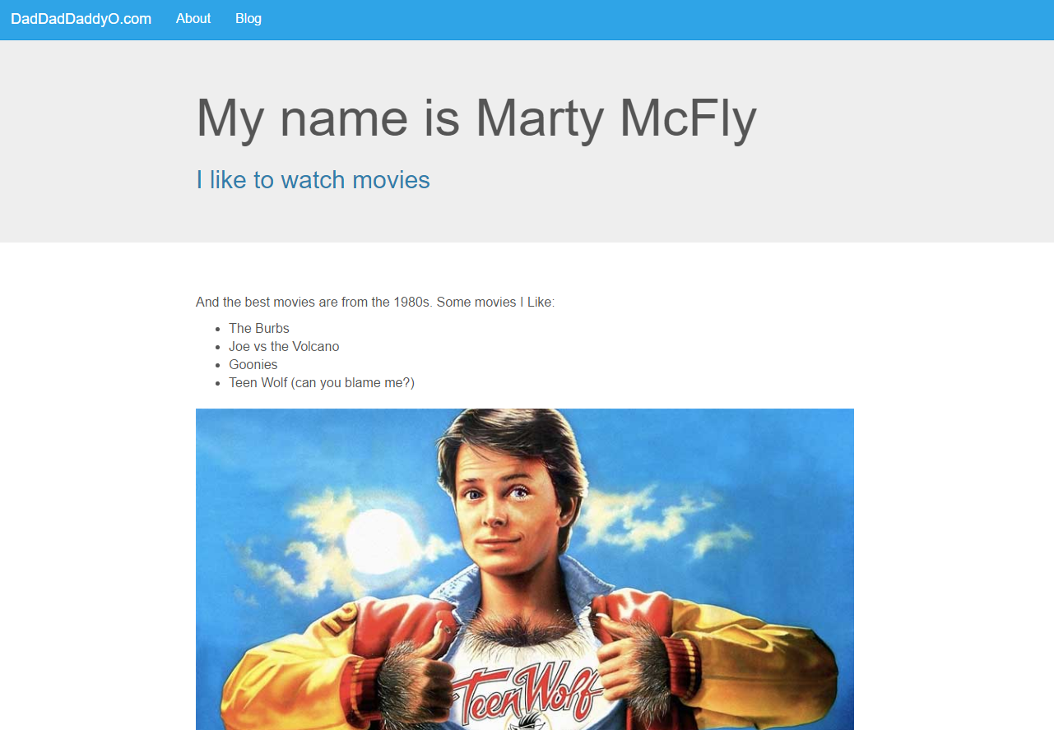








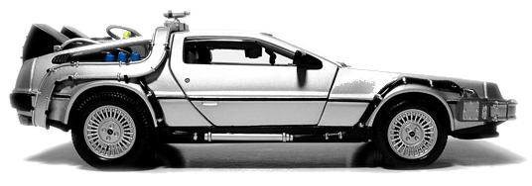
Before
Now
Notes:
TODO – geocitiesized image
TODO – bootstrapped image
TODO – add geocities “logo” at before?
the before time
geocities
static html, css, & blink tags
after before
we built dynamic back-ends
first scripting languages
then fuller, better frameworks
this made developers lives easier
less copy paste
but it was still the dev’s job to manage the content
before now
so we built cms’s
with gui’s for content editing
so now our friends in marketing could manage the site
and this was great, because it freed us up to do things we want to do
and now
everything looks like this

Slide 5
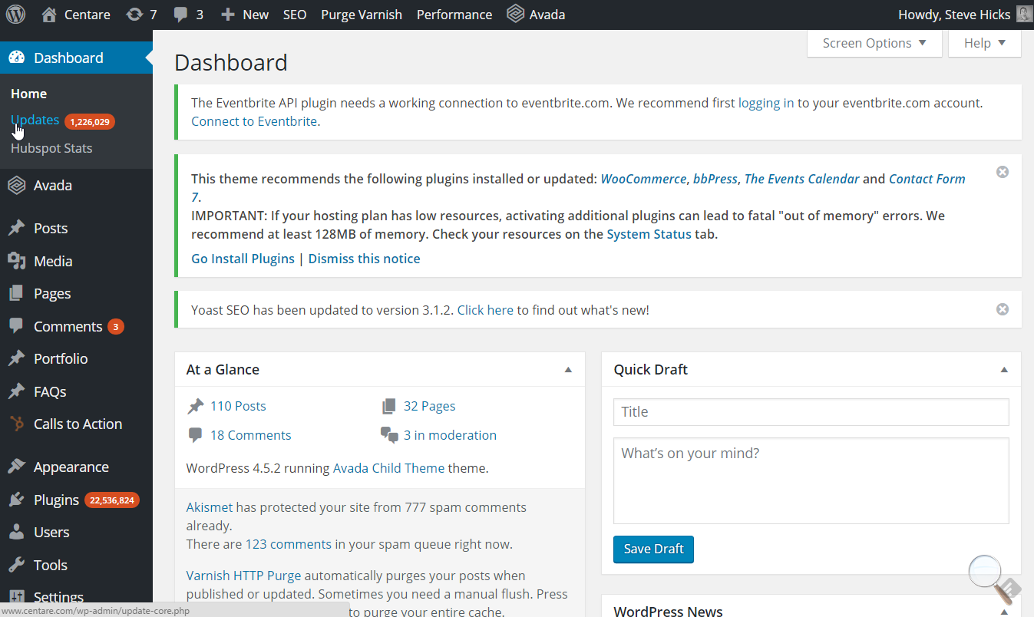
Notes:
and a whole lot of sites look like this

Slide 6
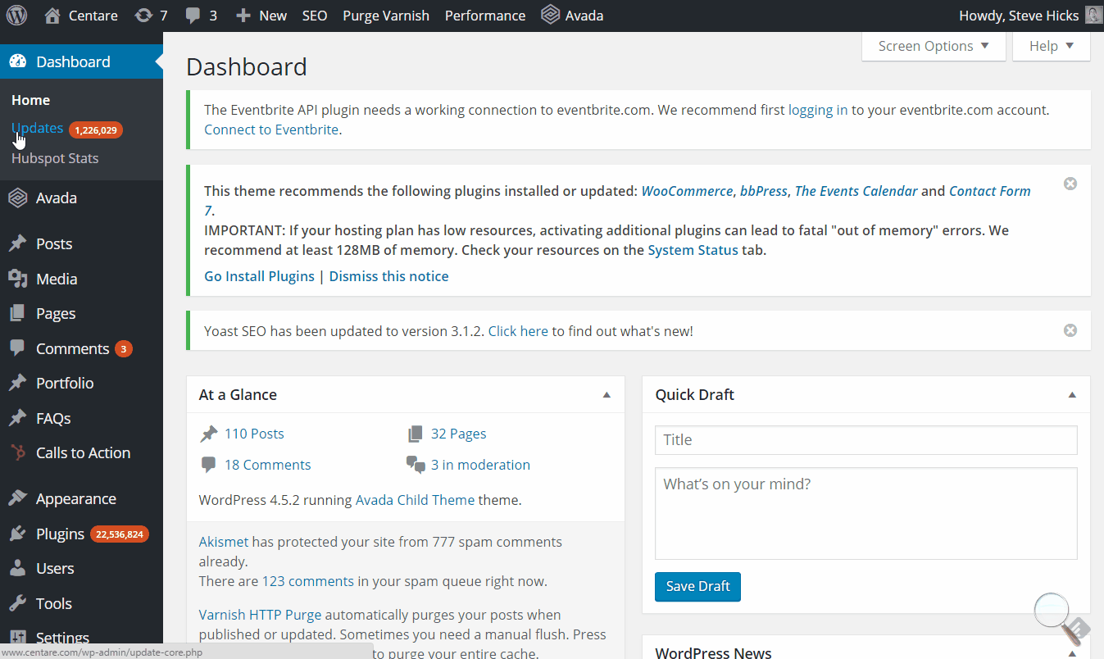
Notes:
and some days, it feels like the whole internet looks like this

Slide 7
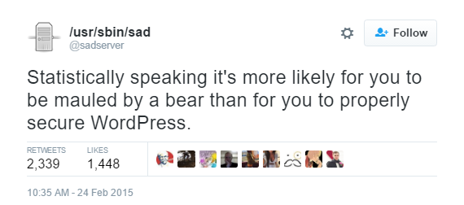
Notes:
and other days it feels like this

Slide 8
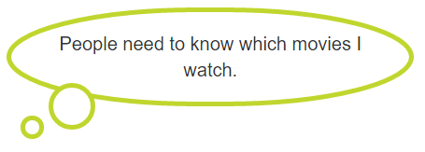
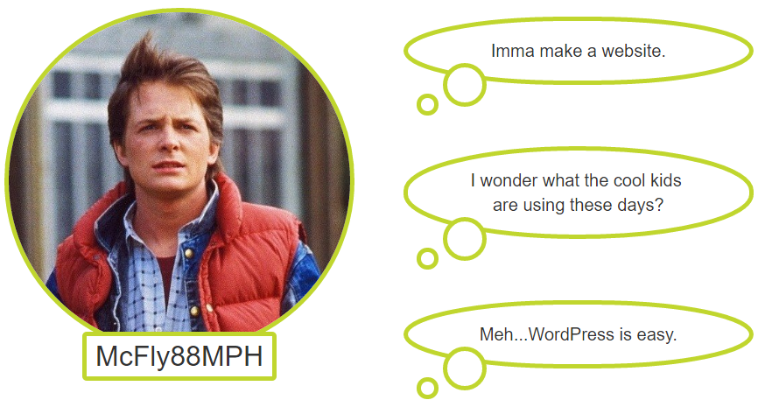
THE SLIPPERY SLOPE
Notes:
this is a pretty typical scenario
inspiration strikes (people need to know…)
and a website is born (imma make a website…)
as a good developer, you do your research to keep up with current trends (I wonder what….)
but the sea of information is overwhelming
and you fall back into old habits

Slide 9
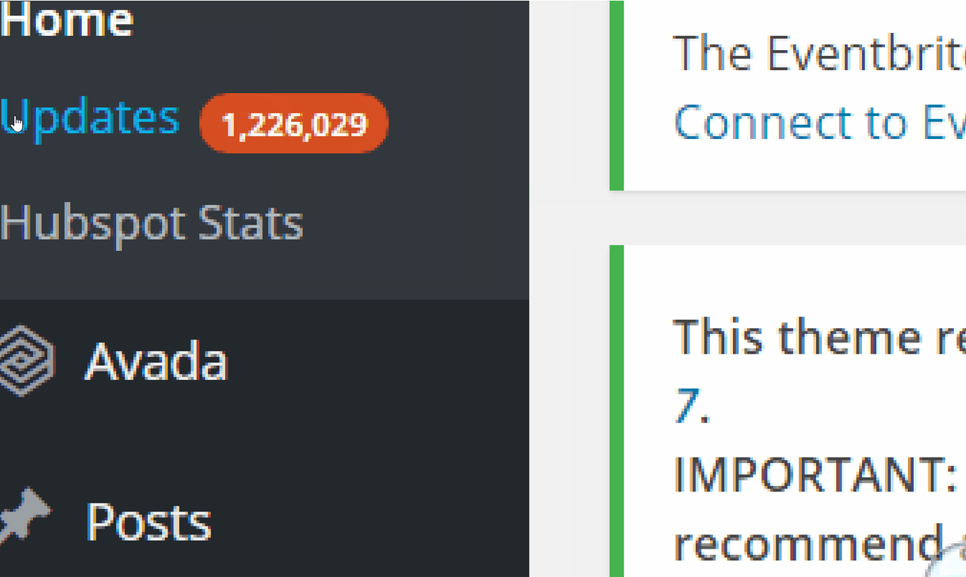
THE SLIPPERY SLOPE
Notes:
and before you know it
you’re staring at the giant number
in the big red badge
in a state of fear and panic,
wondering how much is going to break when you click update.

Slide 10

THE ALLURE OF THE DYNAMIC CMS
“I’m so easy to set up”
Notes:
but who can blame us?
Fabio comes riding in on horseback,
long hair flowing
nearly shirtless
representing the dynamic cms
and he tells us

Slide 11
THE ALLURE OF THE DYNAMIC CMS
“I’m simple enough for your mother to use”
Notes:
even your mother can use my admin

Slide 12
THE ALLURE OF THE DYNAMIC CMS
“Any other way would be a maintenance nightmare”
Notes:
and he harkens back to our good old days
of geocities and blink tags and scrolling marquees
and he reminds us how difficult it was to maintain static content back then

Slide 13
THE ALLURE OF THE DYNAMIC CMS
“That’s just how you do it, baby”
Notes:
and eventually we’ve heard his arguments so many times
that we just go on autopilot

Slide 14

A HERO RISES
“Are we using the right tool?”
Notes:
but today a hero rises
and he has some questions for us
johnny five wants to know if we are using the right tool to build our sites?

Slide 15
A HERO RISES
“Is your content truly dynamic?”
Notes:
he wants to know if our content is as dynamic as we think it is?
If every user sees the same thing, isn’t that really static content?

Slide 16
A HERO RISES
“How often does your content change?”
Notes:
And if the content doesn’t change that frequently,
why do we need to drive it dynamically?

Slide 17
A HERO RISES
“Is a dynamic site worth the cost of support?”
Notes:
And one other question johnny 5 asks that is rarely thought about
until the cost of support is overwhelming

Slide 18
SURPRISING NUMBERS
25%
of websites on the internet run on WordPress
http://pleepleus88.github.io/wordpress-runs-25-percent
Notes:
TODO – add quote footer instead of footnote and shortened link
and he shows us some numbers that are surprising
this number has actually gone up to 26

Slide 19
SURPRISING NUMBERS
70%
of WordPress installs are vulnerable
http://pleepleus88.github.io/wordpress-vulnerabilities
Notes:
of those wordpress installs that run 25% of the internet,
70% of them are vulnerable to things like
xss
sql injection

Slide 20
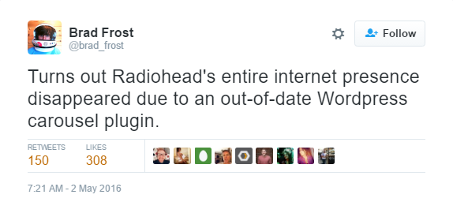
SURPRISING NUMBERS
20%
of the top 50 WordPress plugins are vulnerable
http://pleepleus88.github.io/wordpress-vulnerabilities
Notes:
and that’s just the engine itself.
even though that 70% was bigger,
20% is the scarier number
because you know wordpress has developers on top of security flaws in the engine
with vulnerable plugins, you don’t know
if the developer even knows it’s vulnerable,
or when they’ll fix it,
or if they even know how.
(tweet)
so this is a joke…..but it doesn’t seem far from possible.

Slide 21
GOALS
Notes:
NOT to dismiss the value of wordpress and other CMS’s
wordpress is a great platform
working for a lot of people
so many people that it has a huge target on its back
1. main goal: OFFER COMPELLING ALTERNATIVE to dynamic cms
and that alternative is static website generation
2. survey the landscape of ssg
3. help you decide if ssg works for you

Slide 22
WHAT DO YOU MEAN “STATIC”?
And why do you keep putting it in quotes?

Slide 23






DYNAMIC WEBSITES
Content is generated dynamically, upon request
Custom build
CMS
Notes:
to define “static” websites, let’s first define “dynamic” websites
Server-side logic
Content stored in database

Slide 24
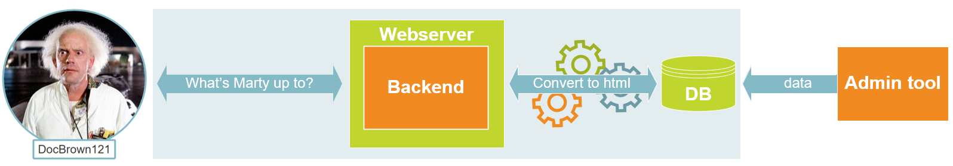
DYNAMIC WEBSITES

Slide 25




“STATIC” WEBSITES
Content is stored statically on the server as html
Typically built with a static site generator

Slide 26
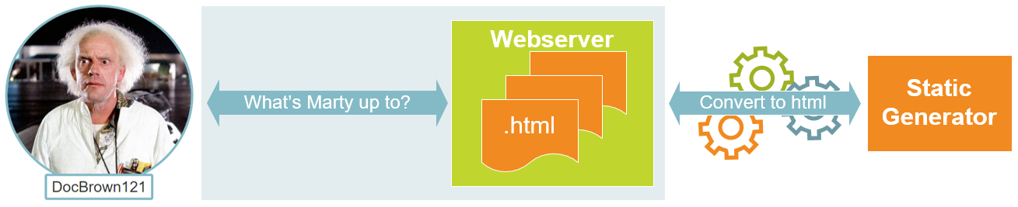
“STATIC” WEBSITES

Slide 27
DYNAMIC VS “STATIC”
DYNAMIC
STATIC
Notes:
if you look back 20 years to the “before” time, when we were all hosted on geocities and we all knew that a marquee tag was the only guaranteed way to make a statement, it is not much different than the static sites I’m describing here.
but the tooling now is so much better.

Slide 28
THINGS “STATIC” DOES NOT MEAN
“My website’s content never changes”

Slide 29
THINGS “STATIC” DOES NOT MEAN
“My website’s content is not interactive”
Notes:
TODO – define interactive

Slide 30
THINGS “STATIC” DOES NOT MEAN
“My website’s content is boring and outdated”

Slide 31
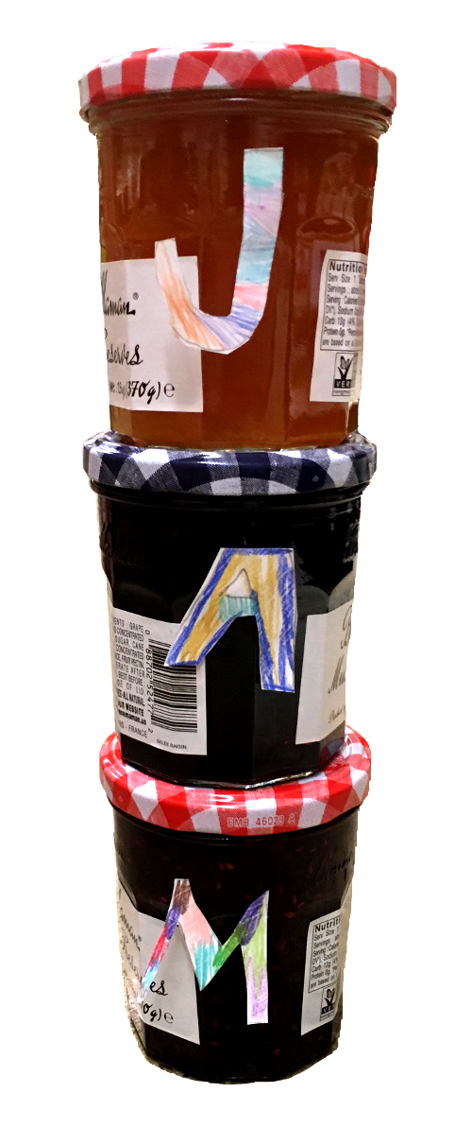
The JAM Stack
JavaScript
APIs
Markup
http://www.jamstack.org
Notes:
TODO - pretty images – jelly jars
coined by Matthias Biilman, founder and CEO of Netlify
does a lot of work in the static space

Slide 32
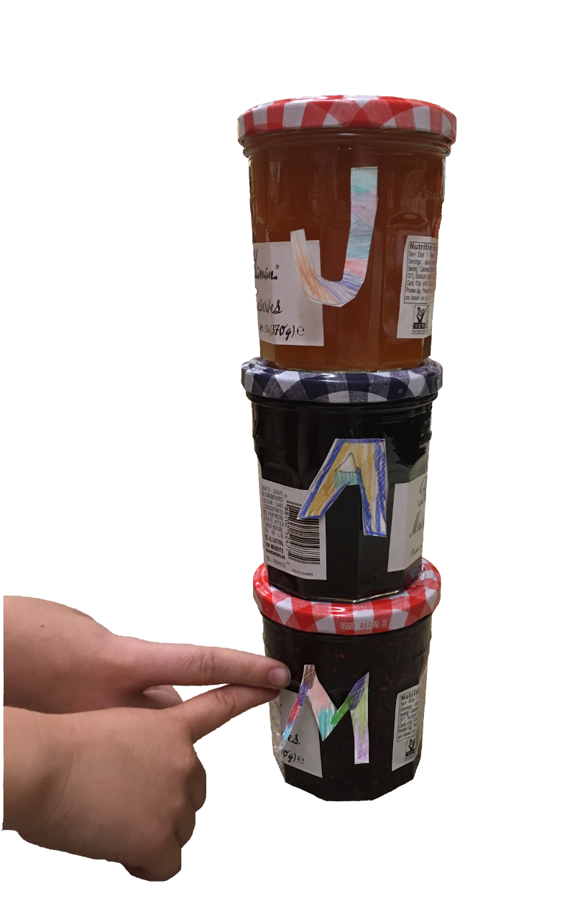
“M” IS FOR MARKUP
Static Site Generators

Slide 33
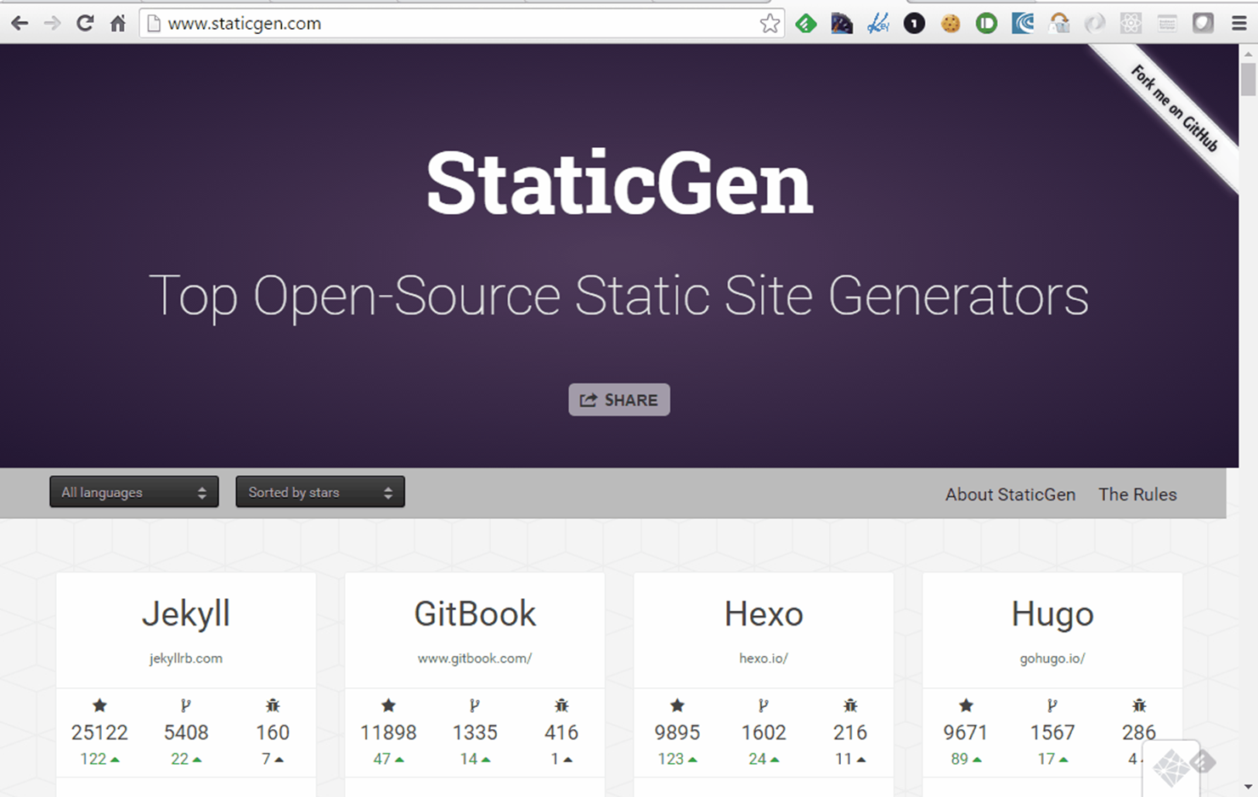
www.staticgen.com

Slide 34
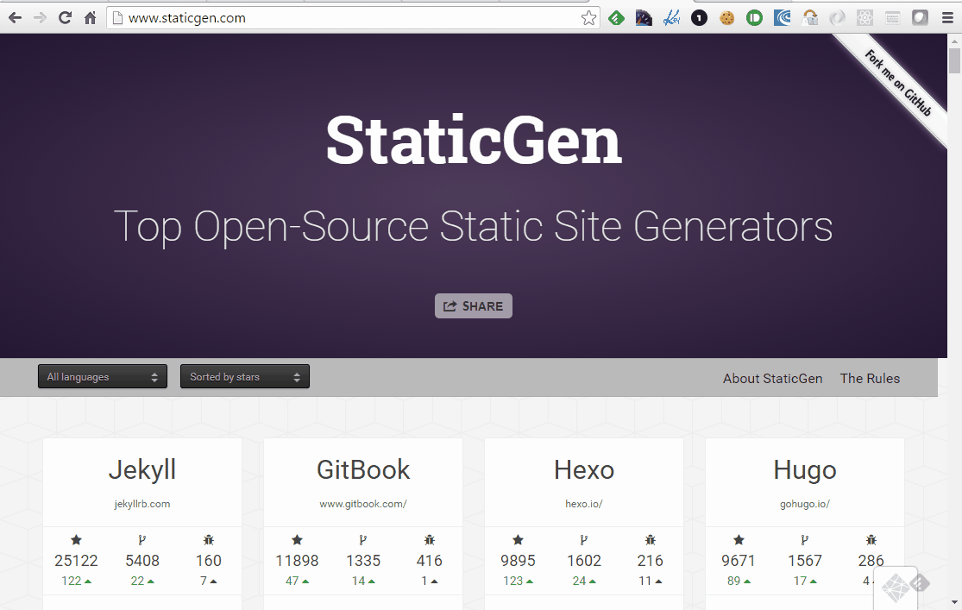
www.staticgen.com
Notes:
and you’re going to see a scrollbar
so you’re going to scroll
and you’re going to see A LOT of generators.
hundreds
so it can be overwhelming to even get started.
there are some general assumptions we can make about all of them, though.

Slide 35
HOW DO I INSTALL?
Each generator is different
All have good tutorials
Notes:
to get set up,
each one is going to be different
but all of them are going to have a good tutorial and documentation.

Slide 36
HOW DO I CUSTOMIZE?
All let you write your own CSS/LESS/SASS
Some support themes
Notes:
if you’re lucky, you’ll get support for themes
and if you’re really lucky, there will be a good amount of themes.

Slide 37
HOW DO I WRITE CONTENT?
Using your favorite text editor
And your favorite markup and templating languages
TEMPLATE
MARKUP

Slide 38
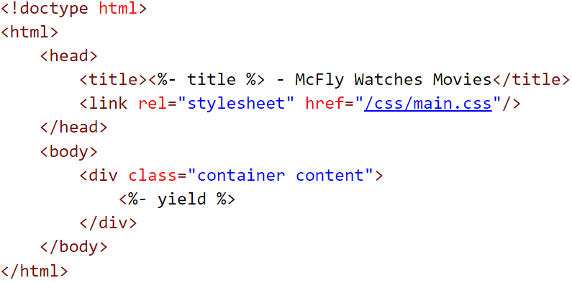
TEMPLATING - EJS

Slide 39
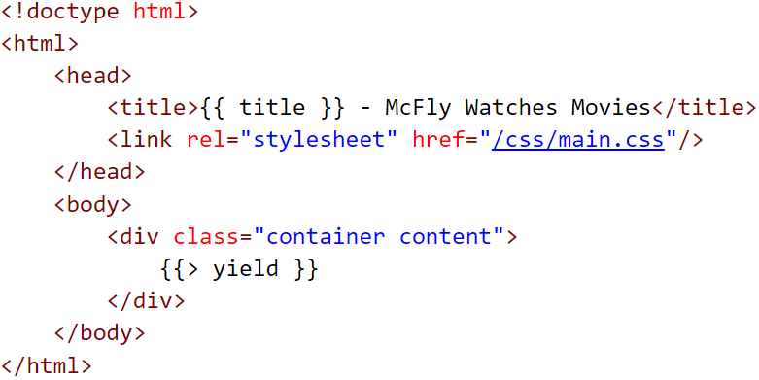
TEMPLATING - HANDLEBARS

Slide 40
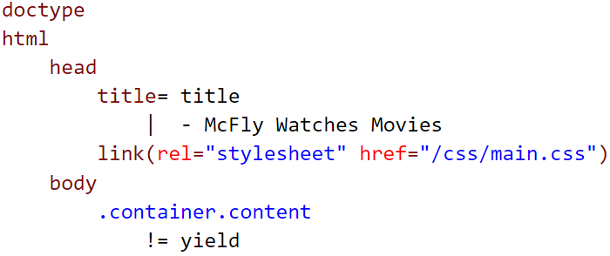
TEMPLATING - JADE

Slide 41
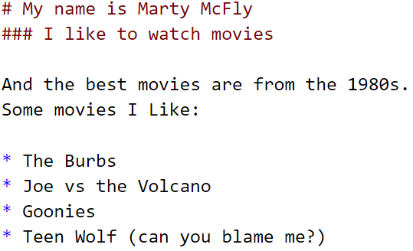
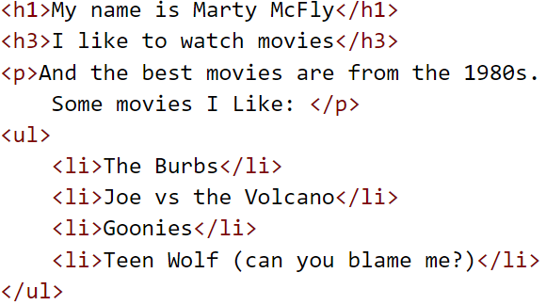
MARKUP - MARKDOWN
MARKDOWN
HTML

Slide 42
DEMO
Creating a simple “static” site with Harp

Slide 43
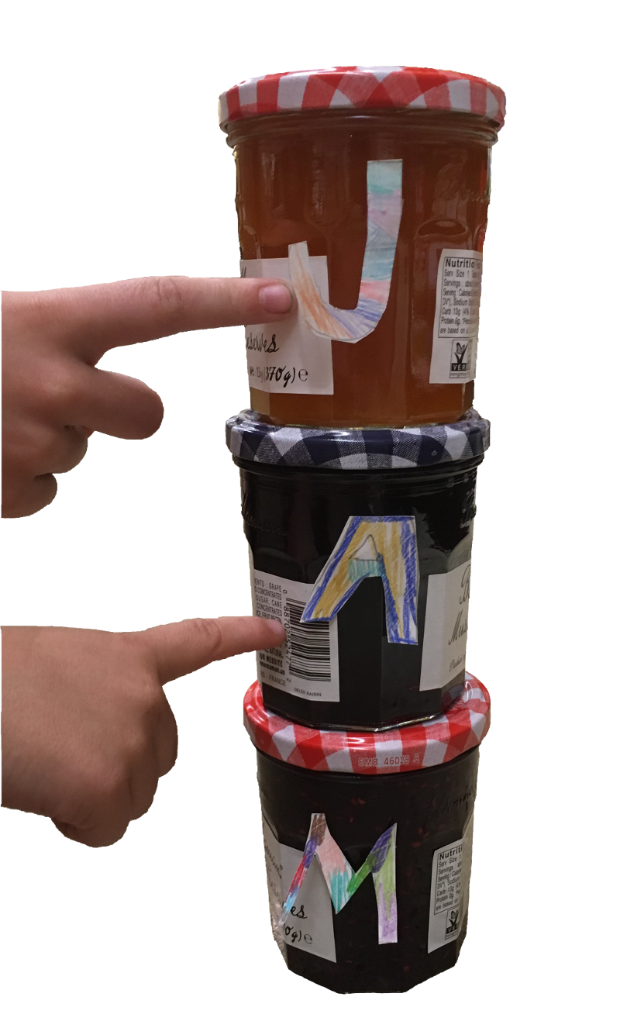
“A” IS FOR APIS, “J” IS FOR JAVASCRIPT
Notes:
we’ll talk about these together because they go hand in hand
apis could be anything from a widget embedded into a page
like facebook feed
to restful apis that you consume with javascript
these are all ways to make your site interactive
and seem more like a dynamic site

Slide 44
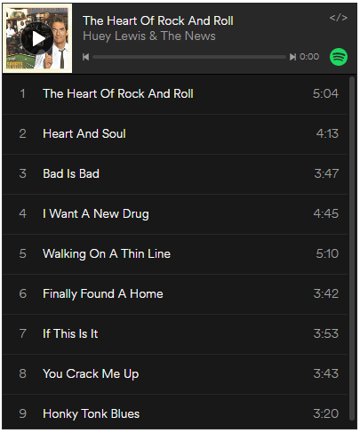
SOCIAL PLUGINS
Facebook
Twitter
Spotify
SoundCloud
http://www.spotify.com
Notes:
These typically are more A than J.
You drop in a snippet of javascript or an iframe on the page,
and it embeds a widget.

Slide 45
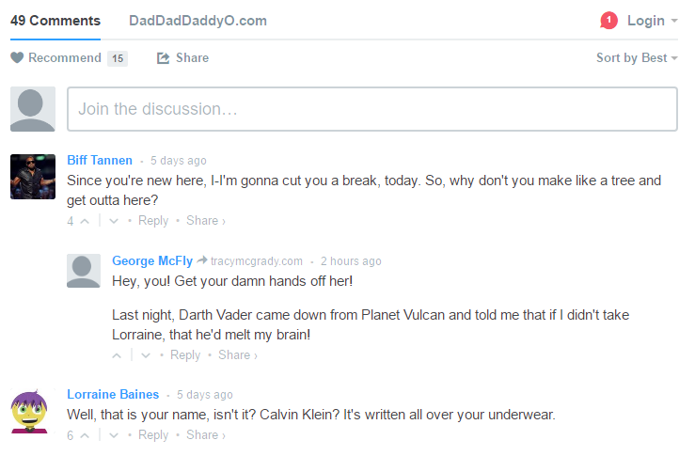
COMMENTS
Disqus
Muut
Discourse
http://www.disqus.com
Notes:
Mostly A, not much J.
disqus – very popular commenting system. pulled in via javascript
muut – similar to disqus, less popular, possibly harder to set up
discourse – costs a good amount of money for a hosted solution, but supposed to be a pretty advanced and user friendly commenting system.

Slide 46

FORMS
Google
Typeform
FormKeep
http://www.typeform.com
Notes:
These can be very light on the J, or a little more heavily.
Google – very light on the J
not very good looking
you can spot a google form from a mile away
formkeep – heavier on the J.
comes from the world of static gen.
you submit an ajax form to their url, they collect the data.
you can have them email you, create a trello card, send a slack message…
typeform – not much J
very fancy looking forms
embedded via iframe

Slide 47
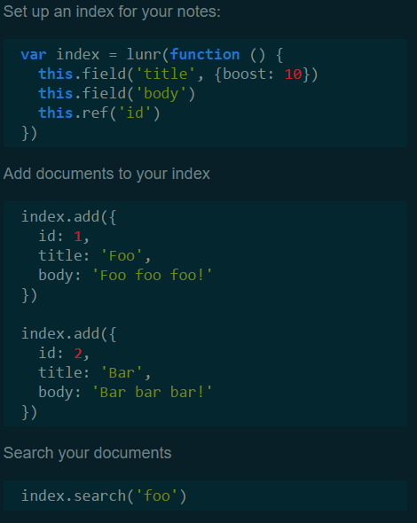
SITE SEARCH
Google Site Search
Lunr.js
Swiftype
List.js
http://www.lunrjs.com
Notes:
Again, these can vary in terms of the amount of J.
The obvious way to do search is Google Site Search.
But I am not the biggest fan, and if you are not either, there are ways to do site search that better fit your branding.
Lunr.js
can take in a json file with all of your content
which can be generated by your static generator
you write the javascript to consume the json, and have lunr search it.
Swiftype
pretty extensive RESTful search api.
it can crawl your site to build up its index
you will be writing the javascript to hit the RESTful api.
List.js
List.js is not really meant to search all content on your site, as much as it is meant to sort and filter content that is shown on the page.
But it is kind of a neat project, and worth noting, if something like that is all you need for searching.

Slide 48
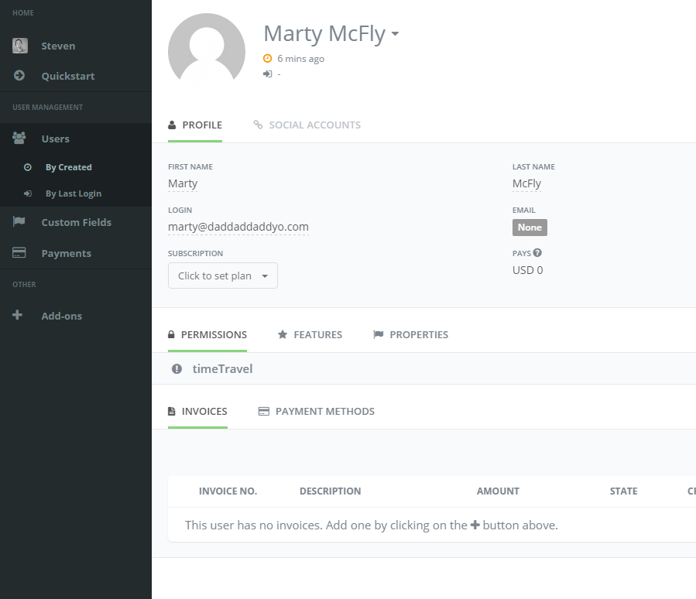
USER PROFILES
Firebase
UserApp.io
http://www.userapp.io
Notes:
Now we’re getting more into the Javascript heavy integrations.
Firebase is a great solution for storing user information, and accessing it via JavaScript.
It is more of a general “cloud database” solution, you are really just storing JSON documents.
Firebase is undergoing some change right now – Google announced recently that they are investing a ton in Firebase.
There are a ton of brand new features, way beyond just user authentication and data storage.
UserApp.io is a similar concept, but really focused on user management.
they have a nice user administration portal that goes with their product

Slide 49
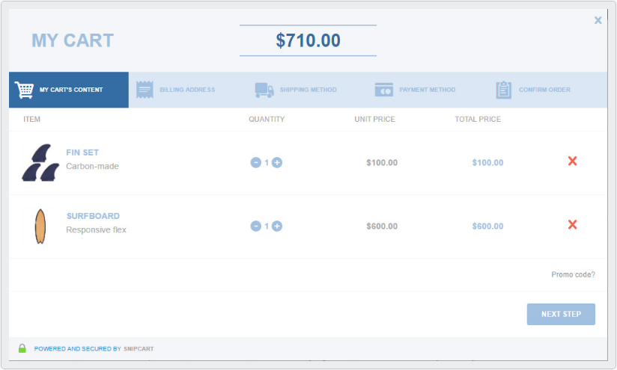
COMMERCE
SnipCart
Moltin
http://www.snipcart.com
Notes:
snipcart –
snipcart is more of a “drop-in” solution
you include their javascript on your page
add some data- attributes to buttons on your site
and their script binds the shopping and checkout process to a click of that button
all without leaving your site
moltin –
moltin is way more J heavy.
they provide an API for you to consume.
you write the javascript to interact with their shopping and checkout process.

Slide 50
WHY GO “STATIC”?
And when is it appropriate?
Notes:
so we’ve talked about all the pieces in the jam stack
but now it’s time to drive home my sales pitch

Slide 51

WHY SHOULD YOU GO “STATIC”?
Speed
Faster delivery of content
Notes:
Static html files serve faster
Static html files are CDN ready
image:
https://flic.kr/p/5rsfQJ

Slide 52

WHY SHOULD YOU GO “STATIC”?
Security
Fewer attack vectors
Notes:
Dynamic back-ends are susceptible to many different types of attacks.
Static sites reduce this greatly.
The only thing that’s really hackable is the webserver itself.

Slide 53

WHY SHOULD YOU GO “STATIC”?
Simplicity
Fewer moving parts
Notes:
Fewer moving parts, and therefore fewer points of failure.
You don’t have to worry about your database going down
You don’t have to worry about when to clear the server cache

Slide 54

WHY SHOULD YOU GO “STATIC”?
Scalability
CDN ready
Notes:
As a result of the simplicity, your entire site is CDN ready.
Think about all the effort you’ve invested over the years in optimizing database calls and caching strategies,
and trying to move as many things to a CDN as possible.
When your entire site can live on a CDN..that is a huge scalability win.

Slide 55
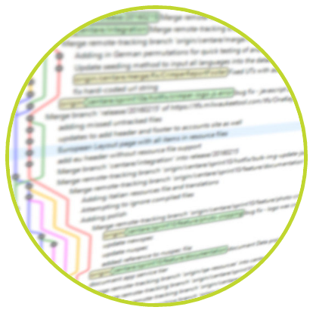
WHY SHOULD YOU GO “STATIC”?
Source control
Built-in history
Notes:
Your content is stored in your source control repository
If you want to know what a page looked like on a certain date,
or who changed it and when,
you just browse the commit log.

Slide 56


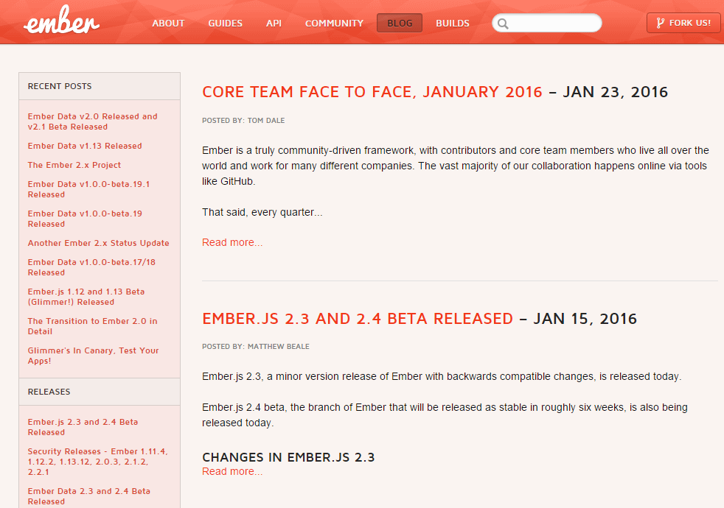
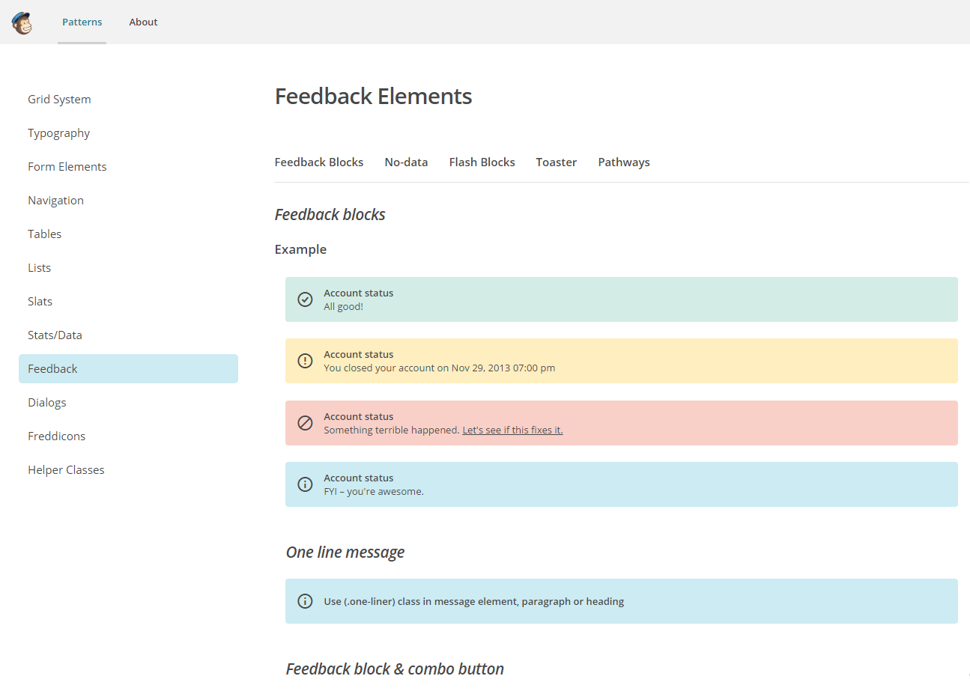
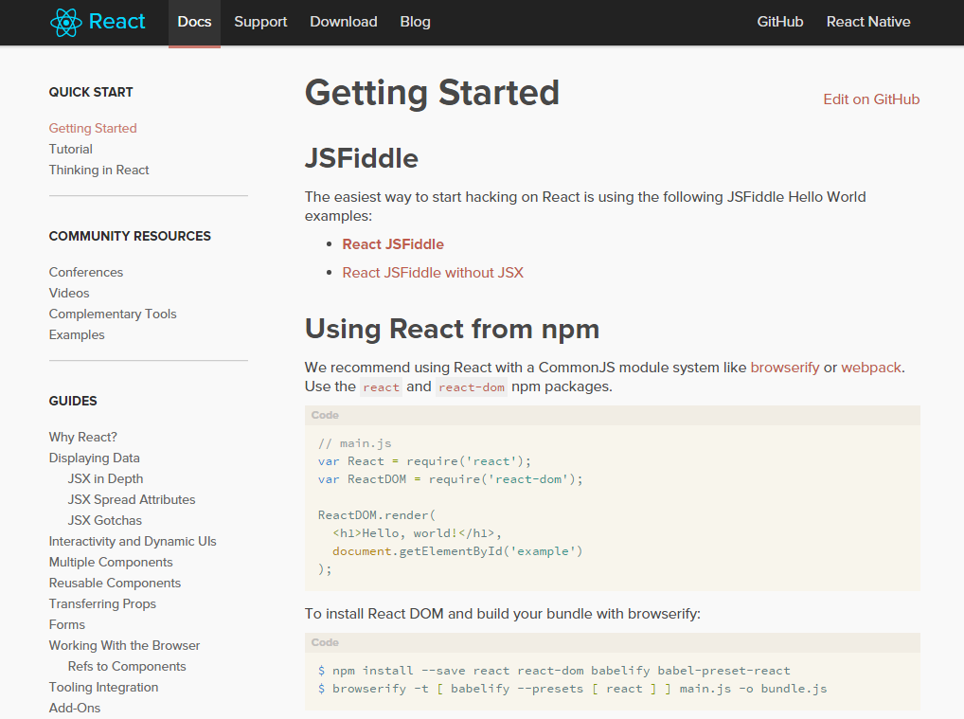
WHEN SHOULD YOU GO “STATIC”?
You are building a simple site
Blog
Portfolio
Brochure site
Documentation
Style guide
http://emberjs.com/blog/
http://www.isabelsbakery.com/
http://www.meikenixdorf.com/
http://facebook.github.io/react/docs/
http://styleguide.mailchimp.com/
Notes:
blog
a blog has just the right amount of content for a static site.
and it changes relatively infrequently,
compared to something like a news feed.

Slide 57

WHEN SHOULD YOU STAY DYNAMIC?
Your content changes A LOT
Every content change rebuilds the site

Slide 58
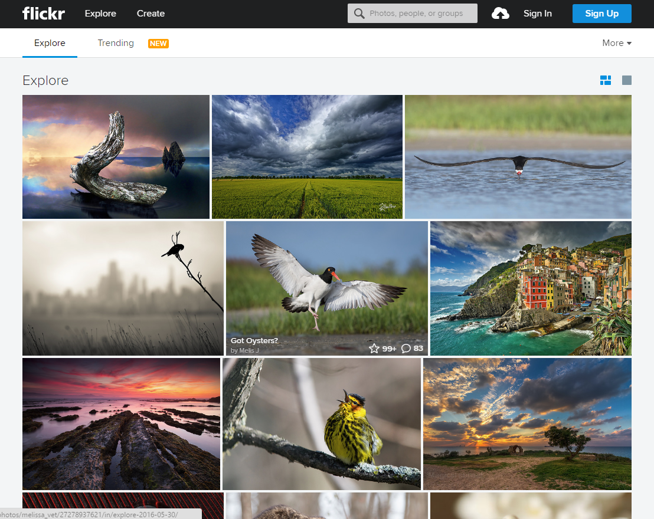
WHEN SHOULD YOU STAY DYNAMIC?
Your content is truly dynamic
User-based content
Complex filtering and searching
Extensive product taxonomies

Slide 59

WHEN SHOULD YOU STAY DYNAMIC?
You are scared of the command line
Though now is a good time not to be

Slide 60

WHEN SHOULD YOU STAY DYNAMIC?
Your content authors lack technical skill and/or courage
Content is written with a templating language
There are admin UI’s, but all have challenges

Slide 61
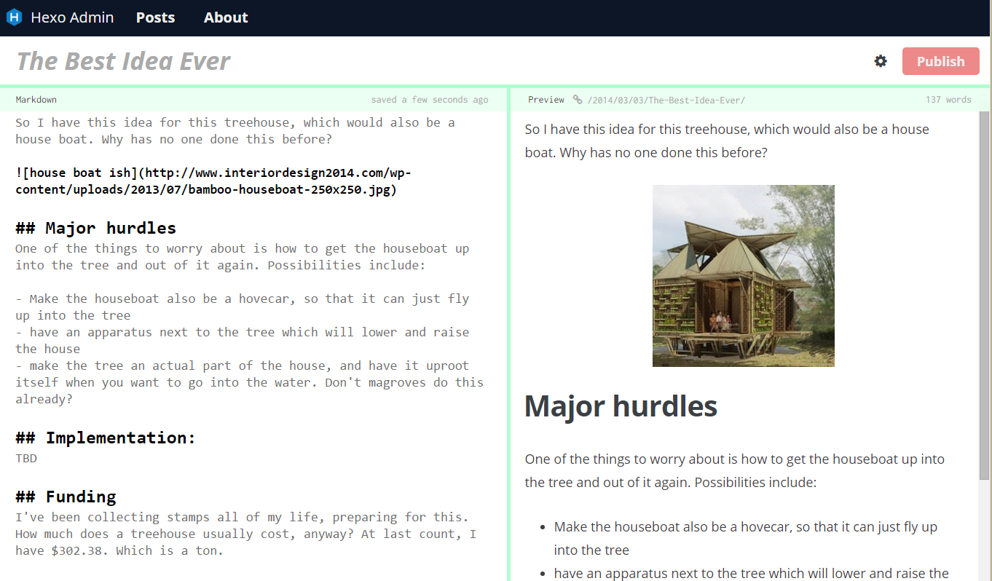
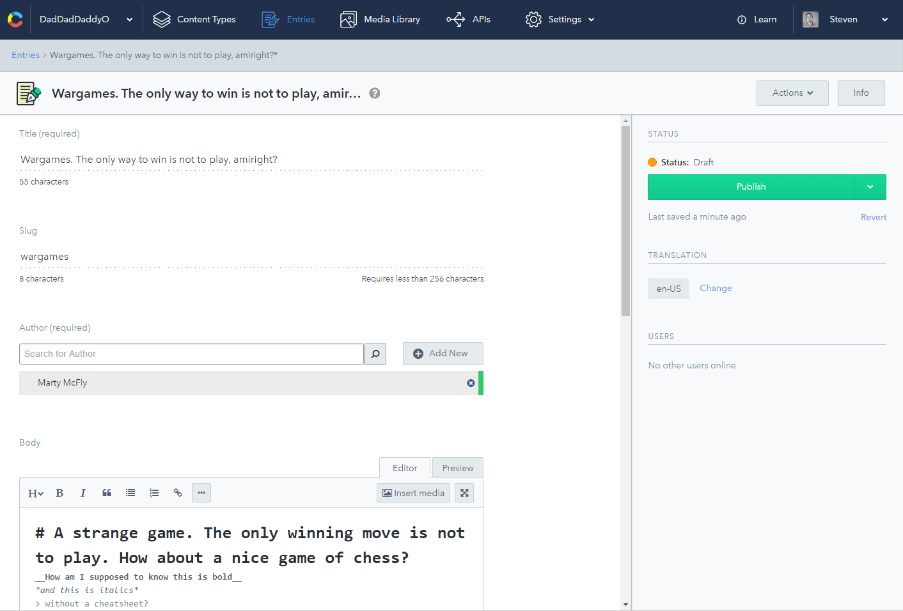
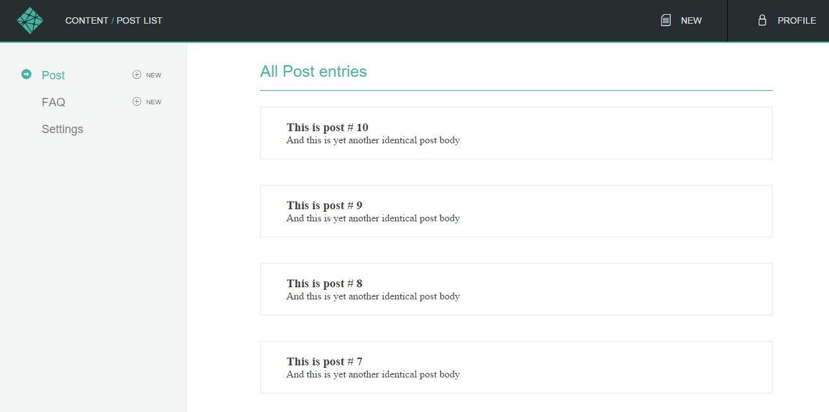
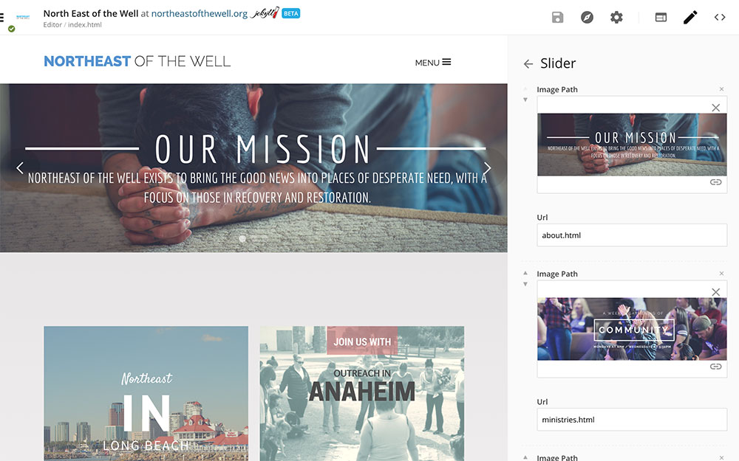
ADMIN UI CHALLENGES
Hexo Admin
Lacks features
Netlify CMS
Lacks features
CloudCannon
Jekyll only
Contentful
Still uses markdown

Slide 62
HOW DO I GET STARTED?
CHOOSING A STATIC GENERATOR

Slide 63

WHICH ONE IS RIGHT FOR ME?
It depends on your criteria

Slide 64
POTENTIAL CRITERIA
Engine language
Templating language
Simplicity vs customization
Plugin support
Frontmatter support

Slide 65
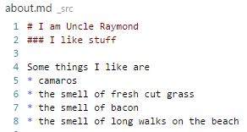
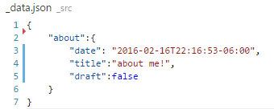
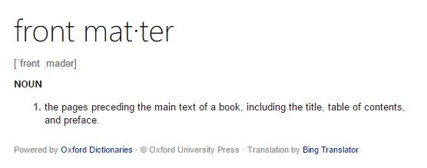
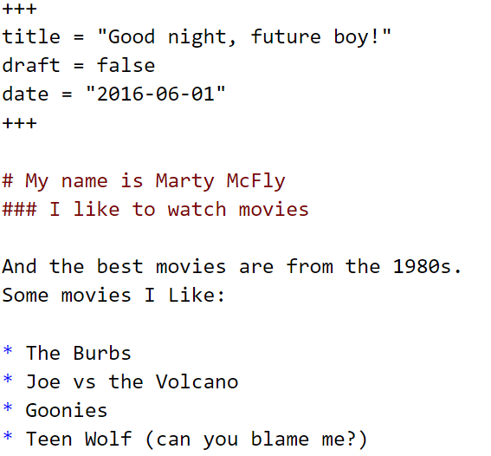
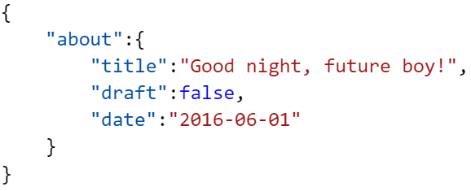

FRONTMATTER
This is frontmatter
This is not frontmatter

Slide 66
SOME OPTIONS
PRO
CON
Support
Themes
Not JavaScript

Slide 67
SOME OPTIONS
PRO
CON
Fast
Support
Themes
Low extensibility
Not JavaScript

Slide 68

SOME OPTIONS
PRO
CON
Simple
Support
Opinionated

Slide 69
SOME OPTIONS
PRO
CON
Simple
Low extensibility
No frontmatter

Slide 70

SOME OPTIONS
PRO
CON
Extensible
Difficult to set up
Poor documentation

Slide 71
HOW DO I HOST A “STATIC” SITE?
It’s just static files!

Slide 72
HOW DO I HOST A “STATIC” SITE?
Anywhere
Your existing infrastructure
Amazon S3
Github Pages (or BitBucket)
Static hosting providers
Netlify
Aerobatic
Notes:
static hosting providers –
they are more than just hosting
they can also link to your repository, and do the build for you.
Netlify - More supported build engines
Aerobatic – more affordable

Slide 73
WHERE IS “STATIC” HEADED?
Where we’re going, we don’t need….backends…..

Slide 74

WHERE IS “STATIC” HEADED?
For the nerds
There’s no reason not to go static
Notes:
Aurora – devs using sitecore

Slide 75

WHERE IS “STATIC” HEADED?
For the general audience
It needs to be easier to write content
We are getting there!
www.staticgen.com

Slide 76
QUESTIONS?

Slide 77
THANK YOU!

Slide 78
RESOURCES
www.staticgen.com
www.nodejs.org
www.harpjs.com
www.netlify.com
www.contentful.com
www.aerobatic.com
www.jekyllrb.com
www.gohugo.io
www.metalsmith.com
www.roots.cx
www.github.com/netlify/netlify-cms
www.cloudcannon.com
www.hexo.io
www.snipcart.com
www.moltin.com
www.firebase.com
www.userapp.io
www.lunr.js
www.swiftype.com
www.list.js
www.formkeep.com
www.typeform.com
www.disqus.com
www.muut.com
www.discourse.org

Slide 79
IMAGES
https://www.flickr.com/photos/camarada_bakunin/3387283903 - johnny five
https://flic.kr/p/bF54DS - mickey repeating
http://www.link-tothepast.com/wp-content/uploads/2015/01/wargames.jpg - wargames

